Slide 1
googleMap받아오는과정

Slide 2
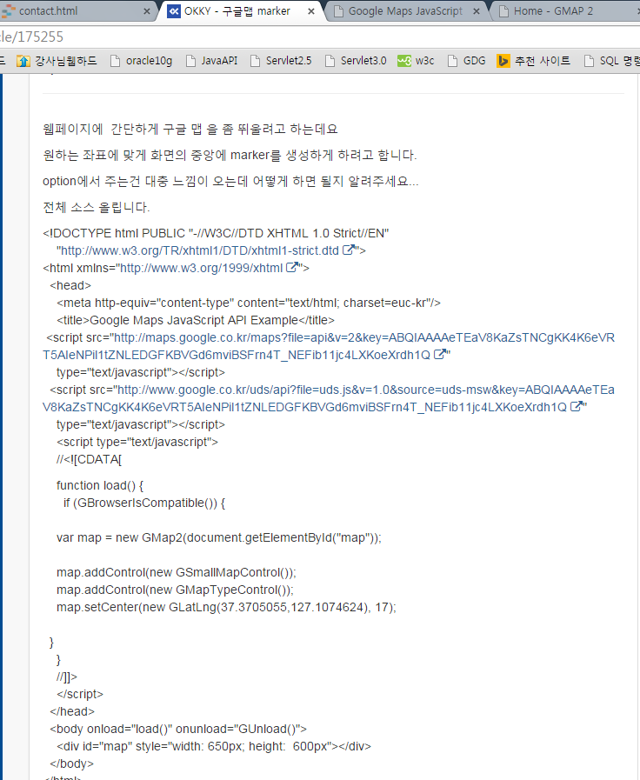
1. Okky.kr에서 긁어옴

Slide 3
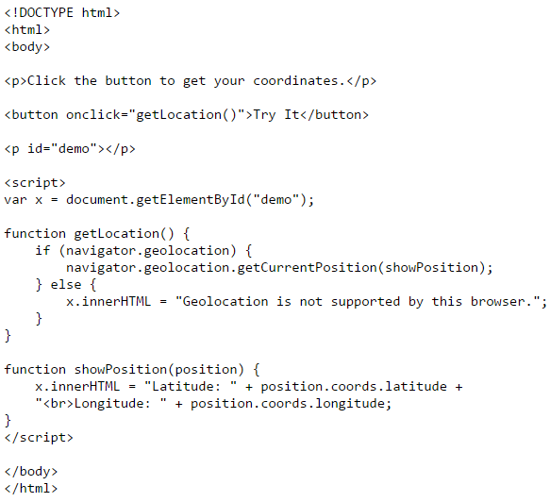
2. W3school에서 긁어옴.

Slide 4
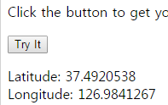
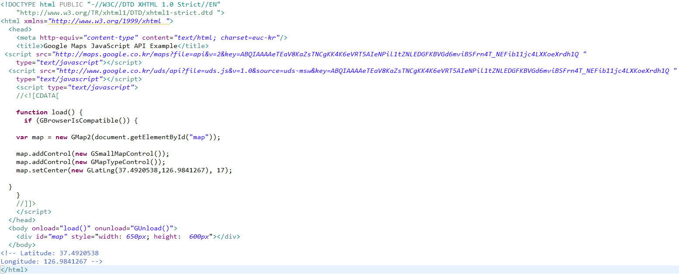
3. 두개 짬뽕
+
=

Slide 5
짬뽕한 코드는 이거.
<!DOCTYPE html PUBLIC "-//W3C//DTD XHTML 1.0 Strict//EN"
"http://www.w3.org/TR/xhtml1/DTD/xhtml1-strict.dtd ">
<html xmlns="http://www.w3.org/1999/xhtml ">
<head>
<meta http-equiv="content-type" content="text/html; charset=euc-kr"/>
<title>Google Maps JavaScript API Example</title>
<script src="http://maps.google.co.kr/maps?file=api&v=2&key=ABQIAAAAeTEaV8KaZsTNCgKK4K6eVRT5AIeNPil1tZNLEDGFKBVGd6mviBSFrn4T_NEFib11jc4LXKoeXrdh1Q "
type="text/javascript"></script>
<script src="http://www.google.co.kr/uds/api?file=uds.js&v=1.0&source=uds-msw&key=ABQIAAAAeTEaV8KaZsTNCgKK4K6eVRT5AIeNPil1tZNLEDGFKBVGd6mviBSFrn4T_NEFib11jc4LXKoeXrdh1Q "
type="text/javascript"></script>
<script type="text/javascript">
//<![CDATA[
function load() {
if (GBrowserIsCompatible()) {
if (navigator.geolocation) {
navigator.geolocation.getCurrentPosition(function(position) {
var map = new GMap2(document.getElementById("map"));
map.addControl(new GSmallMapControl());
map.addControl(new GMapTypeControl());
map.setCenter(new GLatLng(position.coords.latitude,position.coords.longitude),
17);
});
} else {
x.innerHTML = "Geolocation is not supported by this browser.";
}
}
}
//]]>
</script>
</head>
<body onload="load()" onunload="GUnload()">
<div id="map" style="width: 650px; height: 600px"></div>
</body>
<!-- Latitude: 37.4920538
Longitude: 126.9841267 -->
</html>

Slide 6
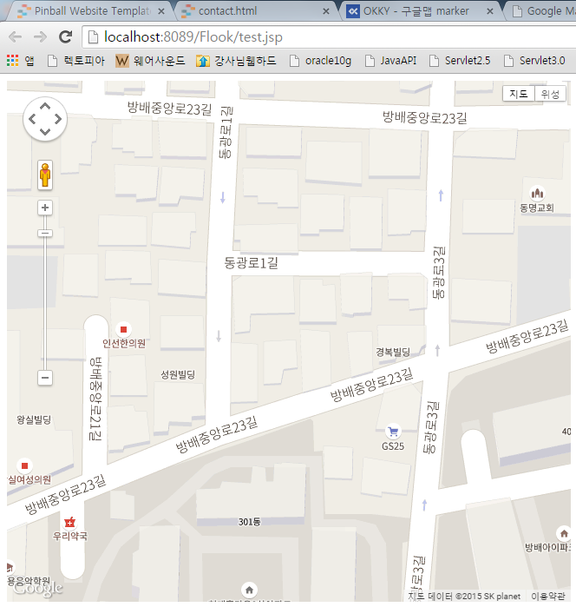
4.컴파일

Slide 7
